Slide 1


MOORED BUOY DATA ANALYSIS USING ADVANCED MACHINE LEARNING METHODS
Guided by –
Guide - Prof. Rajeev Sharma (faculty IITM)
Co guide - Mr. Sundar R (Scientist E, NIOT)

Slide 2

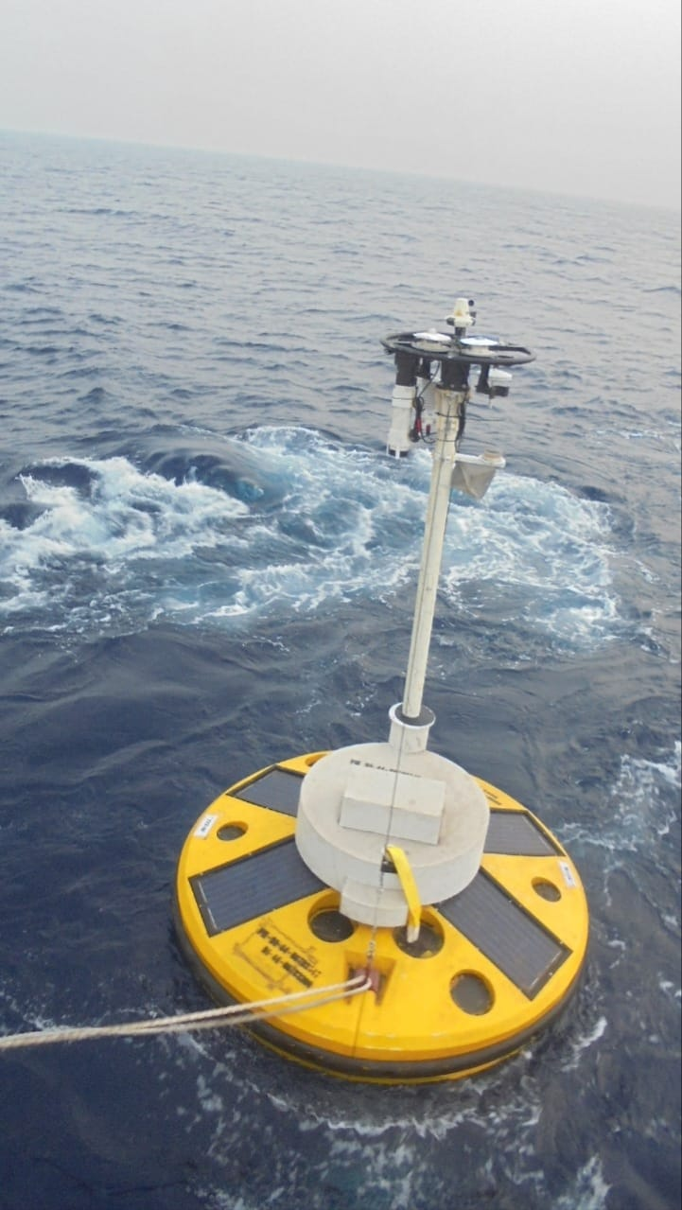
OBJECTIVES
To analyze moored data buoy time series data using advanced machine learning techniques to extract meaningful patterns, trends, and predictive insights
Develop models to predict future values based on historical time series data.
Improve the accuracy and efficiency of traditional data analysis methods by applying machine learning techniques.

Slide 3
LITERATURE SURVEY
RESEARCH PAPER | AUTHOR | SUMMARY
A data-driven methodology for wave time-series measurement on floating structures | Jianhong Zhang , Wenyue Lu, Jun Li , Xin Li, Zhengshun Cheng (journal homepage: www.elsevier.com/locate/oceaneng ) | Paper presents a data driven model that utilizes artificial neural networks to estimate incident wave elevation based on the motion and air-gap responses of floating structures.
Comparing machine learning-based sea state estimates by the wave buoy analogy | Ulrik D. Nielsen , Kazuma Iwase b , Raphaël E.G. Mounet | Paper presents a comparison of three different machine learning frameworks applied in the wave buoy analogy use for estimating the sea state from measured ship responses.
Advanced Moored Data Buoys for Catching Typhoons in the Western North Pacific | Yiing Jang Yang , Chien-Yi Yang, Ming-Huei Chang, Ching-Ling Wei | Article introduced the continuously self improving and power efficient buoys capable of observing meteorogical and ocean data under extreme weather conditions

Slide 4
LITERATURE SURVEY
RESEARCH PAPER | AUTHOR | SUMMARY
The global tropical moored buoy array | M. J. McPhaden , K. Ando , B. Bourlès , H. P. Freitag , R. Lumpkin, Y. Masumoto , V. S. N. Murty , P. Nobre , M. Ravichandran ,J. Vialard , D. Vousden W. Yu | This paper describes the Global Tropical Moored Buoy Array (GTMBA), which is a multi-national effort to provide data in real time for climate research and forecasting. Components of the global array include the Tropical Atmosphere Ocean, the Prediction and Research Moored Array in the Tropical Atlantic (PIRATA), and the Research Moored Array for African-Asian-Australian Monsoon Analysis and Prediction (RAMA) in the Indian Ocean.
Machine learning framework for the real-time reconstruction of regional 4D ocean temperature fields from historical reanalysis data and real-time satellite and buoy surface measurements | Bianca Champenois , Themistoklis Sapsis | This paper presents a computational framework that combines historical model data and real-time sensor measurements. It accurately predicts 4D ocean temperature fields with a median absolute error of 0.97°C.

Slide 5
PROPOSED METHOD
Cleaning and filtering of the data
Raw buoy data often contains missing values and outliers due to sensor malfunctions or extreme weather conditions.
Missing values are handled using techniques such as interpolation, and outliers are detected and removed using statistical methods.
Normalization and Transformation of the data
Data is normalized to ensure all features have a similar scale, improving the performance of machine learning algorithms.
Time series data is transformed using techniques like differencing to make it stationary if required.
Appropriate Feature Selection
Relevant features are selected based on domain knowledge and statistical analysis.
This includes parameters that significantly impact the oceanographic conditions being studied.

Slide 6
MACHINE LEARNING METHODS AND ALGORITHMS
MACHINE LEARNING METHODS
Time Series Forecasting Methods
Like Recurrent Neural network
Classification Algorithms
Support Vector Machine (SVM), Decision Trees
Regression Models
Linear Regression, Polynomial Regression

Slide 7
Algorithm – RNN(Recurrent Neural network)
What are RNNs?
A recurrent neural network (RNN) is a deep learning model that is trained to process and convert a sequential data input into a specific sequential data output. Sequential data is data—such as words, sentences, or time-series data—where sequential components interrelate based on complex semantics and syntax rules.
Capable of using their internal state (memory) to process sequences of inputs.
Key Features:
Sequence Handling: Ideal for tasks involving time series, text, and other sequential data.
Memory of Previous Inputs: Retains information from previous inputs to influence current processing.
Applications:
Time series forecasting
Language modeling and text generation
Speech recognition
Anomaly detection

Slide 8
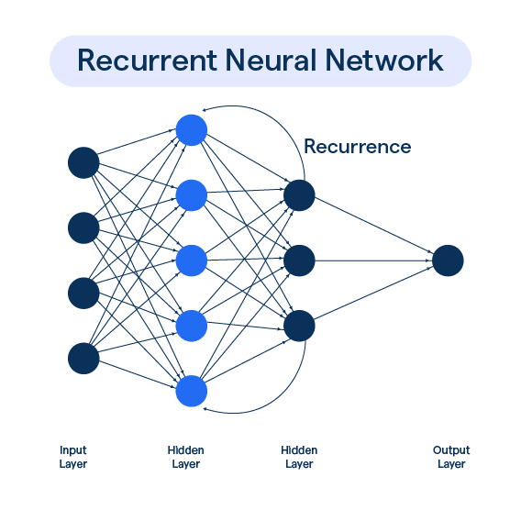
Algorithm – RNN(Recurrent Neural network)
Basic RNN Structure:
Input Layer: Accepts sequential data.
Hidden Layer(s): Each neuron has connections to the previous time step’s hidden state, allowing the network to retain a memory of past inputs.
Output Layer: Produces predictions or classifications based on the hidden states.
Application in Moored Buoy Data Analysis:
Temporal Dependencies: Capturing and predicting oceanographic parameters over time.
Handling Missing Data: RNNs can be adapted to work with incomplete sequences.
Feature Extraction: Learning complex patterns and anomalies in buoy data.

Slide 9
References
www.elsevier.com/locate/oceaneng
www.researchgate.com
www.sciencedirect.com
www.isope.org
https://incois.gov.in/portal/datainfo/mb.jsp

